Slide 1
Web Traffic Prediction
Group 8
Tina Feng
Yinzhe Jin
Yunxin Gu
Zouyiyun Peng
Notes:
12 min in total
Background & Data source & Objective (1min, Chris)
Challenge + EDA (3.5min, Chris)
ML (2.5min, Tina)
LSTM (1.5min, Silvia)
prophet (1min Dylan)
Conclusion (1.5 min, Dylan)
Impact & Future improvement (1 min, Silvia)

Slide 2
Background

Slide 3
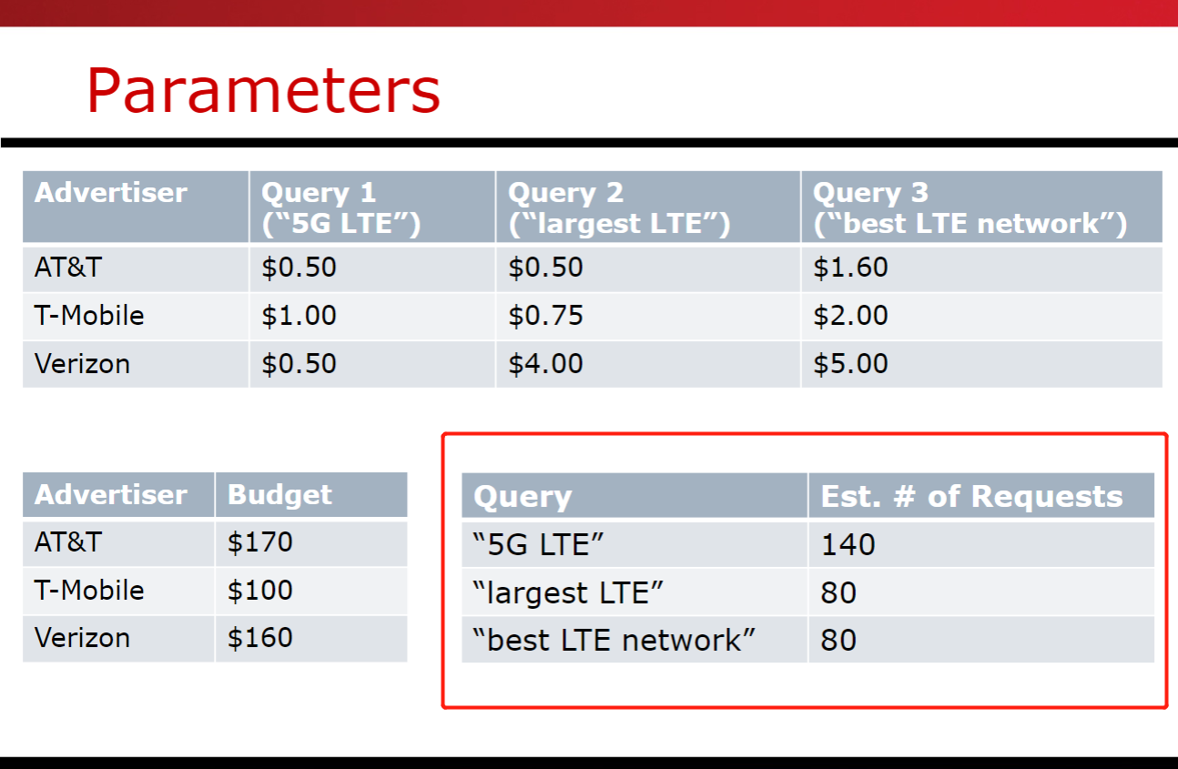
Inspiration
Linear programming – Google Ads example
Query/Visit Estimates are given
Notes:
In the linear programming lecture, we were introduced with the google ads example. In the example, the estimated requests of each page were given, to build up the linear optimization model. We are inspired by this interesting example and hope to dig into how the estimated visits can be calculated in real cases.

Slide 4
Objective
Potential benefits:
Websites: Forecast future fluctuation and take actions in advance
Engineers: Prepare for the peak periods and avoid collapsing
Decision makers: Maximize revenue and advertising growth
We would like to predict the future daily views, as known as web traffic, based on historical daily views. The goal is to achieve as accurate predictions as possible.
Notes:
There are many benefits and applications of predicting website visits. Such as maximizing revenue and advertising growth like in the google ads example. Our objective is to predict the future daily views….
First, for most online businesses, if the web traffic can be predicted and forecasted, they can easily prepare for the future fluctuation and adjust their strategy accordingly in advance. From engineers’ perspective, if the website engineers can be informed that there will be a peak visit in the following week, they can strengthen the endurance of the websites and thus avoid collapsing. And decision makers can get business insights maximize the revenue and advertising growth like in the Google ads example.

Slide 5
Data Source

Slide 6
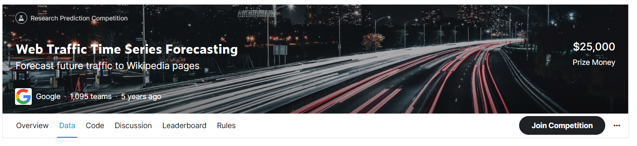
Data Source
train_*.csv - contains traffic data
key_*.csv - gives the mapping between the page names and the shortened Id column used for prediction
sample_submission_*.csv - a submission file showing the correct format
https://www.kaggle.com/competitions/web-traffic-time-series-forecasting/data
Notes:
In this project, we will be using the web traffic time series forecasting dataset from Kaggle. The objective is to forecast future traffic to Wikipedia pages.

Slide 7
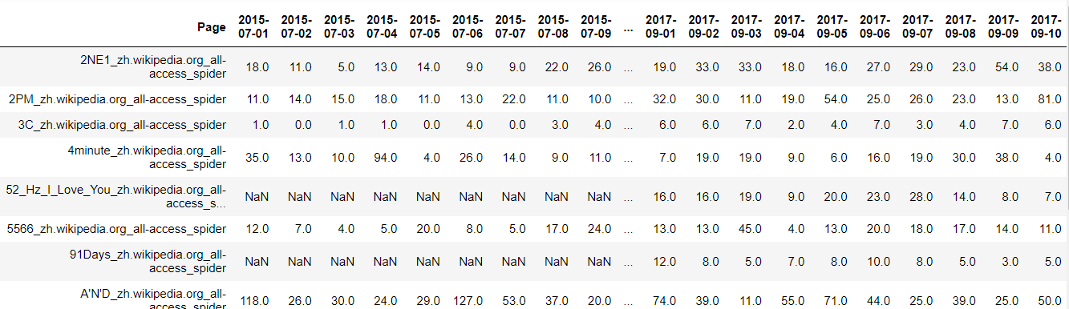
Data Source
145063 rows × 804 columns
2NE1_zh.wikipedia.org_all-access_spider
article name
language code (e.g. en, ja, de)
type of access (e.g. desktop)
type of agent (e.g. spider)
Notes:
Here is the overall looking of the raw dataset, where each row represents each page. And in each row, we have daily visit data from 2015 to 2017. There are 1 hundred and forty-five thousand rows, aka pages. Another point we want to highlight is the page column. Take the first page for instance, the record contains some information about the website that might be useful, including the article name, the language code, type of access and type of agent.

Slide 8
Challenges

Slide 9
Challenges and Solution
Analytics challenge:
the interaction between users and the Internet is a chaos since we cannot simulate every action that a user takes for every second.
Technical challenge:
site performance data aren’t always accurate, such as missing tracking code on web pages, data sampling with skewed results, ad-block services that filter out valuable ad related data.
Data challenge:
A large dataset with a lot of missing values
Policy challenge:
Moral concern of tracking user browsing behavior
Scale down the dataset
ML method that can process the large-scale and time-sensitive data and output useful insights and prediction for future usage
Protect privacy by just obtaining overall view data, not include personal information
Notes:
The project is facing challenges from analytics, technical, data and policy side. Here we wanna highlight that the interaction between users and the Internet is a chaos and site performance data are not always accurate. Our solutions are to scale down the dataset and use machine learning method that can process the large-scale and time-sensitive data

Slide 10
Exploratory Data Analysis

Slide 11
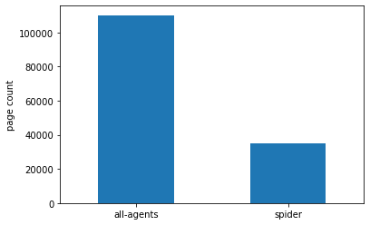
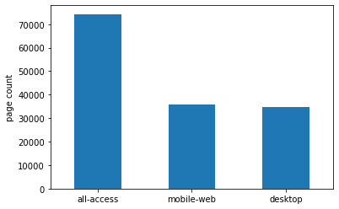
Data Distribution
Page count across agents
Page count across accesses
Notes:
Before diving into the time series data let’s have a look at how the different parameters are distributed. We find that the number of pages that can be only accessed by spider is almost 3 times fewer than that of pages with all agents.

Slide 12
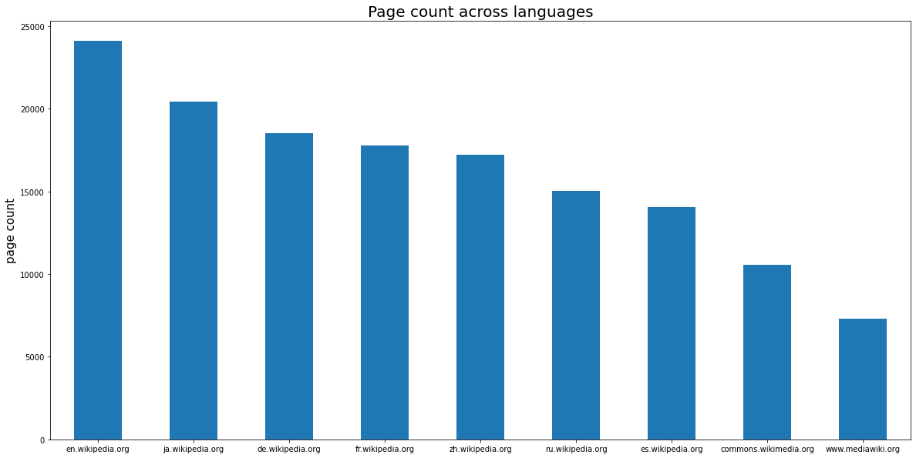
Data Distribution
Notes:
And among all the language parameters, the number of English pages is the most.

Slide 13
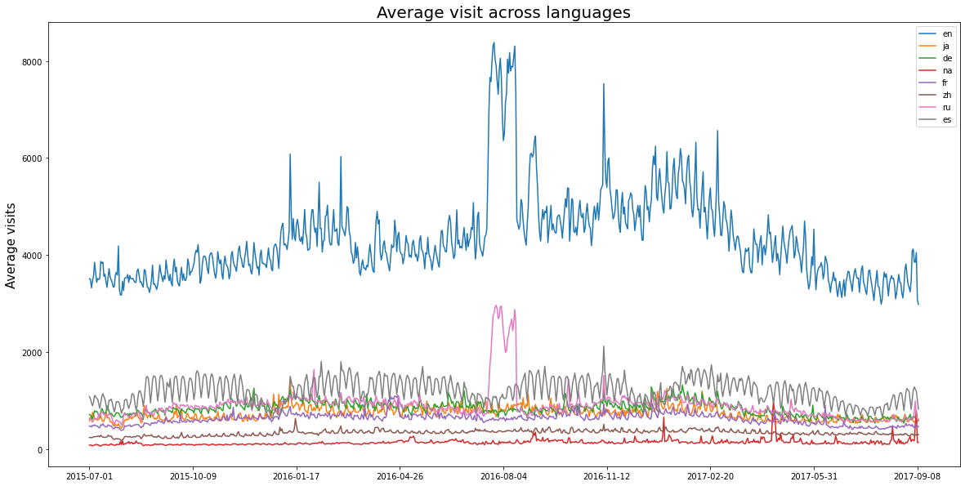
Data Distribution
Notes:
Here is the daily average visits across languages. English page shows a much higher average view, as might be expected since Wikipedia is a US-based site. The English and Russian plots show very large spikes around 2016 August. Our guess is that this is the effect of the Summer Olympics in August.

Slide 14
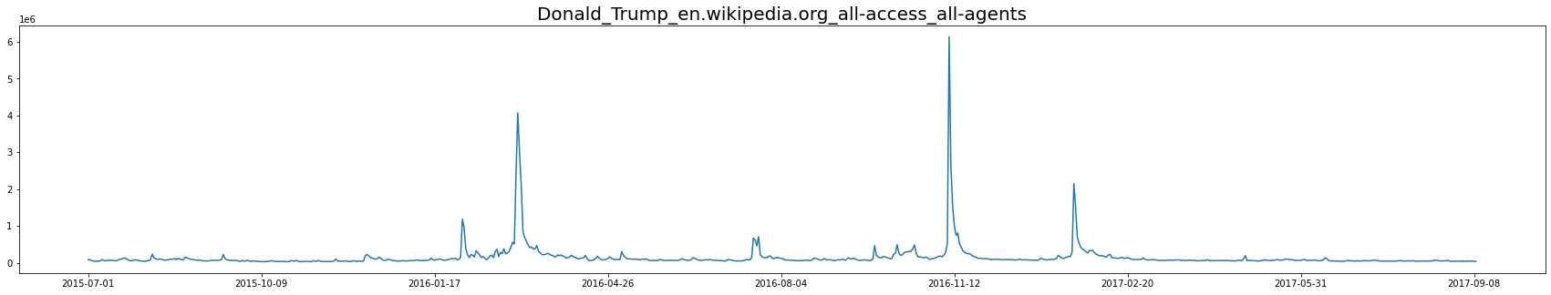
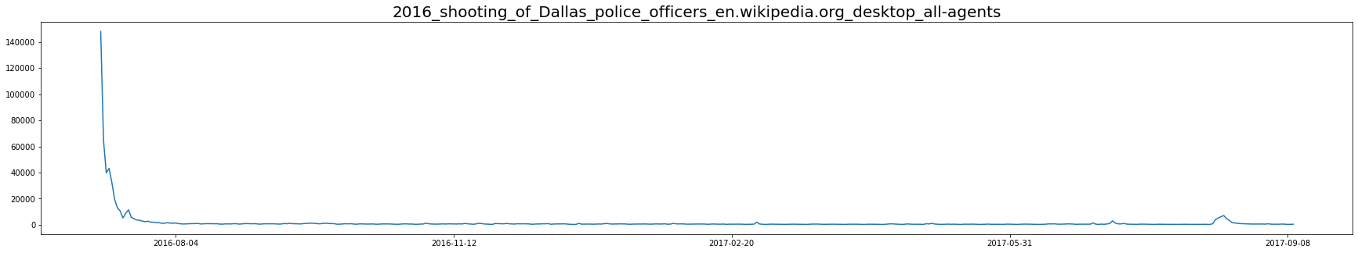
Data Example
Notes:
Here are some data examples. We see that for individual pages, the data are also not smooth.
For example, the page for Donald Trump received a large number of viewers around the beginning and the end of 2016, which is obviously affected by the us election.
As you can see, politics and events related articles usually have sudden gigantic spikes in number of visits, which is hard to capture and predict.
The 2016 shooting of Dallas occurred, and a Wikipedia page was quickly constructed and received a huge number of views in a short time. The number of views mostly decayed away in 2 weeks.

Slide 15
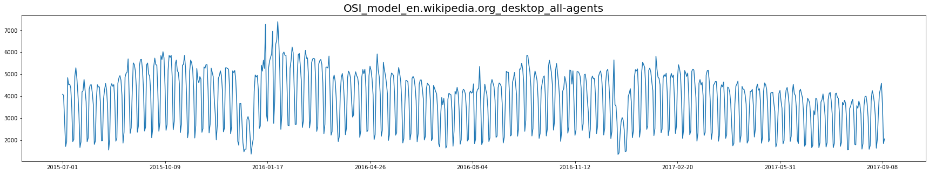
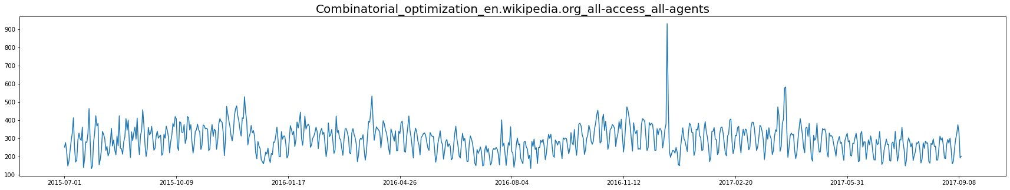
Data Example
Notes:
However, for the visits in articles about for exmaple OSI model and combinatorial optimizations are more stable. This kind of data are more ideal to help us to train the model.

Slide 16
Data Cleaning
Select English pages, and filter out spider access
Delete pages with extreme peaks
Select top 1000 pages with the highest average view
Notes:
To clean data, we select English pages, as they are more explainable and have larger instances. And we filtered out the records with spider access to meet our objective. Then, we delete pages with extreme peaks, by calculating the percentage change and standard deviation. Last, we select the top 1000 pages with the highest average view.

Slide 17
Traditional Machine Learning
Notes:
For modeling, we started with traditional machine learning methods

Slide 18
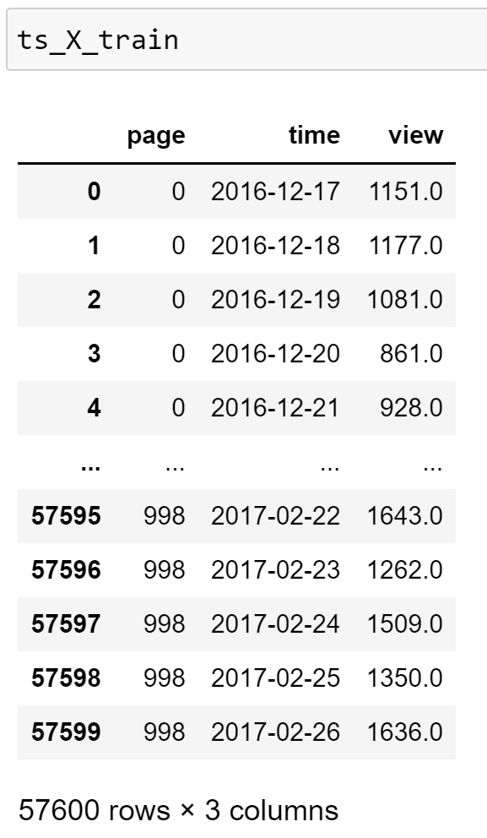
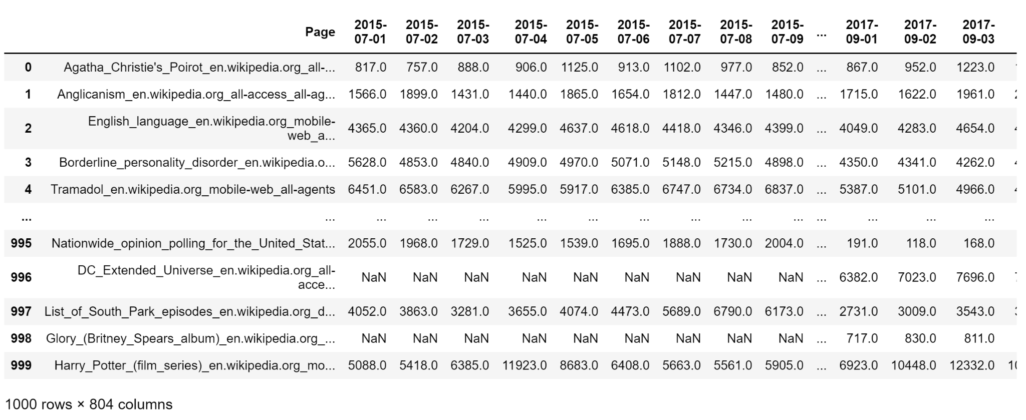
Traditional ML - Preprocessing
Notes:
As can we see, the original data frame is in the format of independent observations in rows and their time series in columns where each value can be a potential target. To do this prediction task in the framework of traditional supervised learning, we need to identify corresponding features with regard to one single target for each row. To achieve this, we did the following preprocessing.
We first unmelt the dataframe into the table format on the right

Slide 19
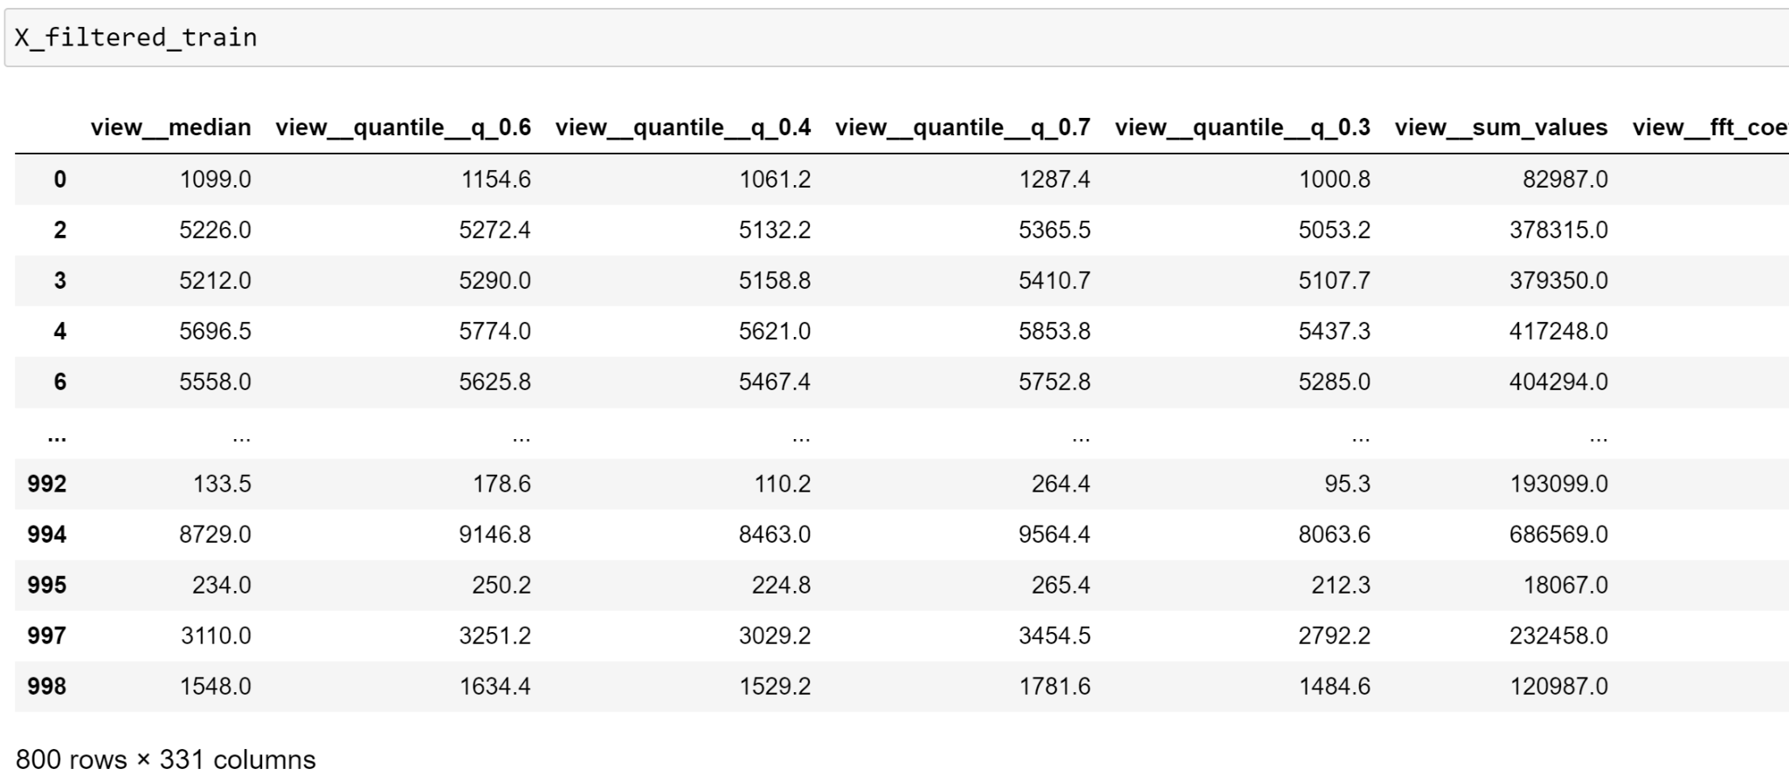

Traditional ML - Feature Engineering
Notes:
The reason to do so is that we’d like to use a python package called tsfresh to automatically extract relevant time series features for each page.
After the feature extraction and some automatic filtering, we got the feature dataframe on the right

Slide 20
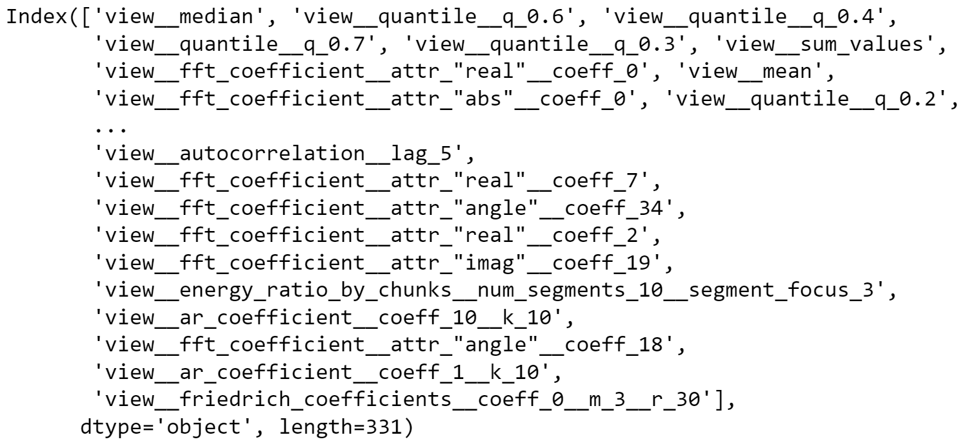
Traditional ML - Feature Engineering
Notes:
Here are a few examples of the extracted features

Slide 21
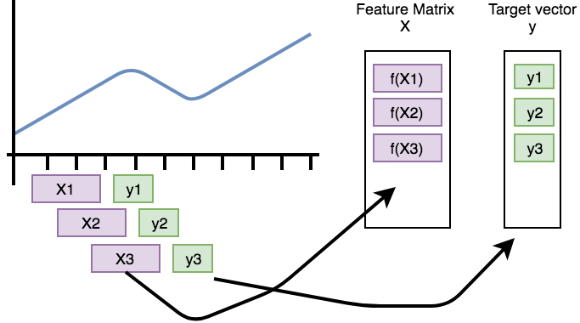
Traditional ML - Modeling
Model Training: Use data of first 73 days (starting from the day with no missing values in all 1000 pages) → use first 72 days to predict visit on the 73rd day
Testing: Use rest dates as unseen data to test the trained model via sliding/rolling windows
Results of each model prediction are visits on a certain day for all 1000 pages. Prediction errors and R-squared are calculated based off the ture visit vector (size 1000 × 1) and the predicted visit vector (size 1000 × 1)
Notes:
Now we can start building the model.
We used data of the first 73 days with no missing values to train the model.
Specifically, we used first 72 days to predict visit on the 73rd day for all pages. Then we would use rest dates as unseen data to further test the model via rolling windows
Ideally we would have trained one model for each rolling window so that we could exploit all available data for model training, but due to the time constraint from feature extraction via tsfresh for all pages in every single window, we only used rolling window for the purpose of testing.
The results of each model prediction are visits on a certain day for all 1000 pages. Prediction errors and R-squared are calculated based off the ture visit vector of size 1000 × 1 and the predicted visit vector with the same size.

Slide 22
Traditional ML - Modeling
 | Train RMSE | Test RMSE | Train R-squared | Test R-squared
Ridge Regression | 1267.97 | 2626.8 | 0.926 | 0.484
Decision Tree | 1770.9 | 1741.2 | 0.855 | 0.773
Random Forest | 895.1 | 1579.5 | 0.96 | 0.81
XGBoost | 787.3 | 1831.8 | 0.97 | 0.75
On rest test data (a total of 123 rolling windows)
Average RMSE: 41.19
Average R-squared: 0.79
Notes:
For model training, we compared ridge regression, decision tree, random forest, and XGBoost. We used root mean squared error and r-squared to evaluate these models, and random forest turned out to be the best model. We then applied this best model to the future 123 rolling windows for further testing, and achieved an average rmse of 41.19 and r2 of 0.79.

Slide 23
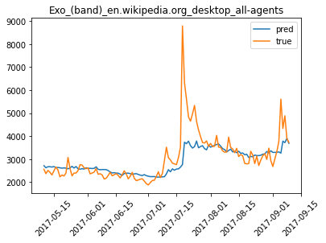
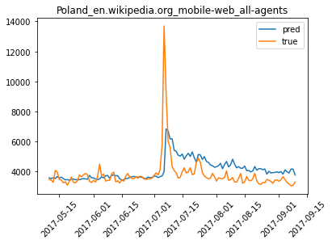
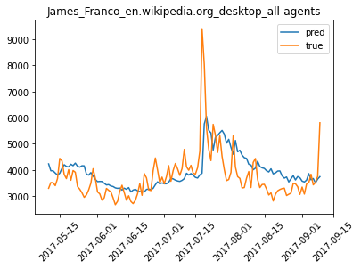
Traditional ML - Visualization
Notes:
Out of 1000 pages, we can see that the predictions from Random Forest are able to catch the overall trend of the time series when the trend is relatively more smooth despite the difficulty to capture some “extreme” peaks.

Slide 24
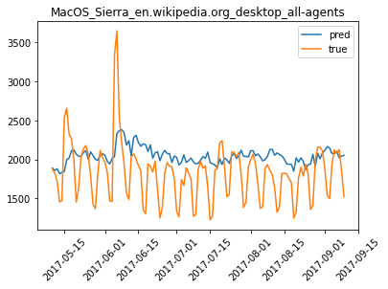
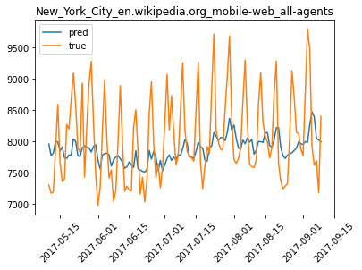
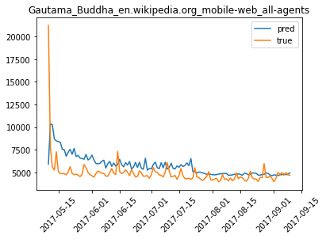
Traditional ML - Visualization
Notes:
On the other hand, the model fails to capture repeated patterns like weekly or monthly ones. This may result from the fact that we didn’t get and thus include relevant features such as day of the week during feature extraction using tsfresh.
However, this problem is well addressed by our deep learning models, and Silvia will talk more about it.

Slide 25
Deep Learning:
LSTM & Prophet

Slide 26

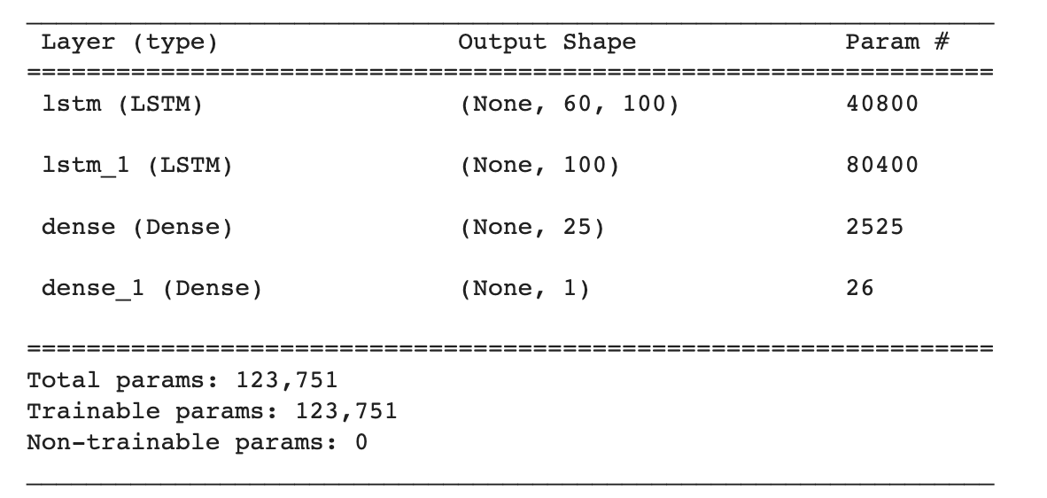
Deep Learning - LSTM
Architecture:

Slide 27
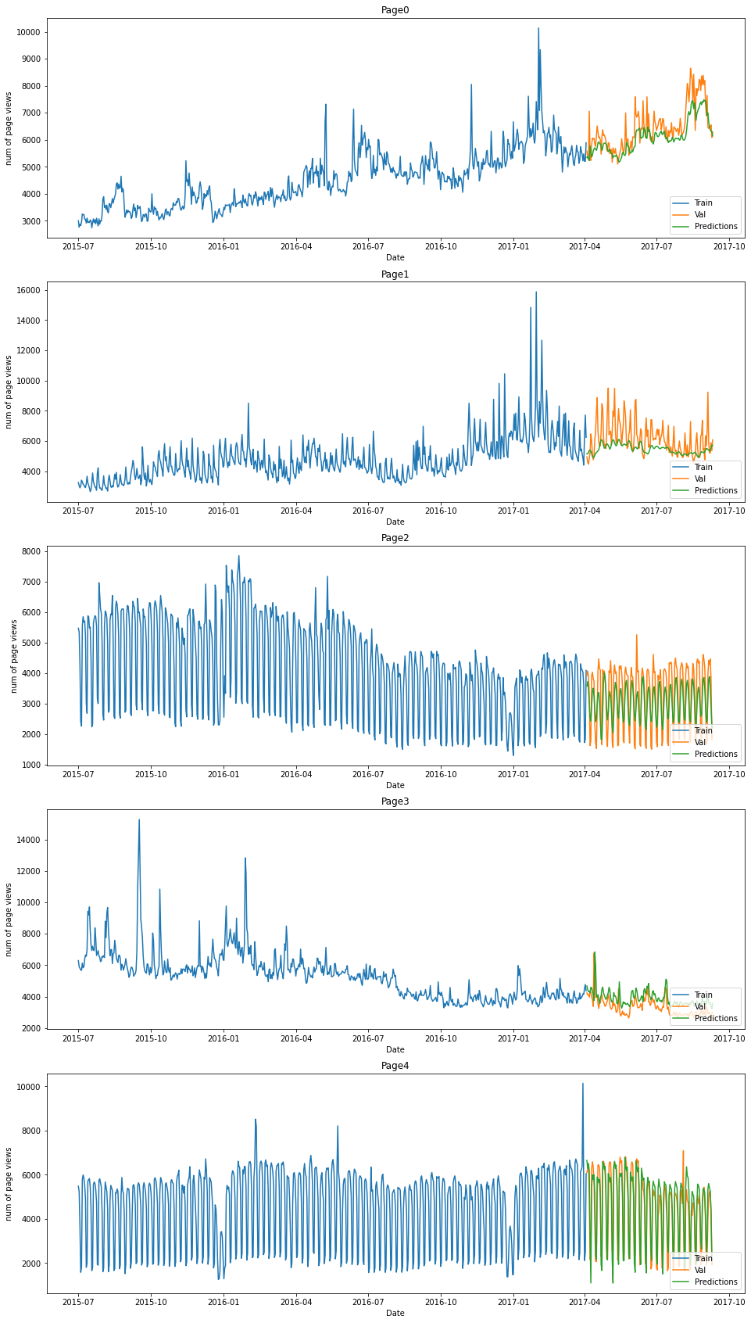
Deep Learning - LSTM experiment on 5 pages
Max R-squared: 0.84
Min R-squared: - 0.46

Slide 28
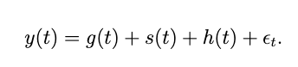
Deep Learning - Prophet
Accurate and fast
Reliable forecasts for planning and goal setting.
Perform great in the majority of cases.
Forecast in just a few seconds.
Fully automatic.
No manual effort.
Robust to outliers, missing data, and dramatic changes
Tunable forecasts.
Can use human-interpretable parameters to improve your forecast by adding your domain knowledge.
Available in R or Python.
trend seasonality holidays
Notes:
In 2017, Facebook published a paper called Forecasting at Scale, the model mentioned in this paper provides a one click experience for time-series forecasting, called Prophet. Almost no prepossessing is needed, and it provides a super fast training process. In brief, the model can catch the overall trend, different seasonalities and the holiday influences and output a great prediction with fancy plots.

Slide 29
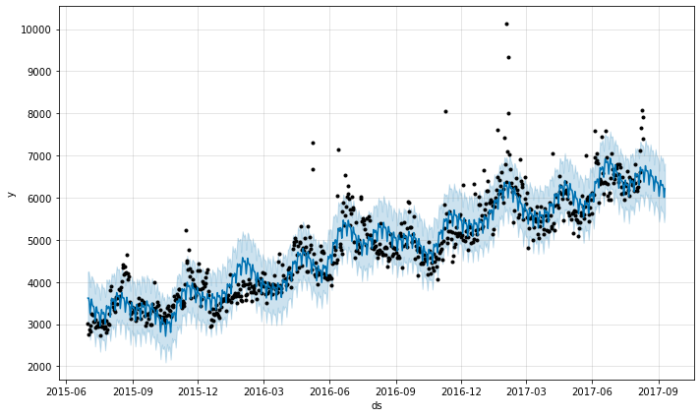
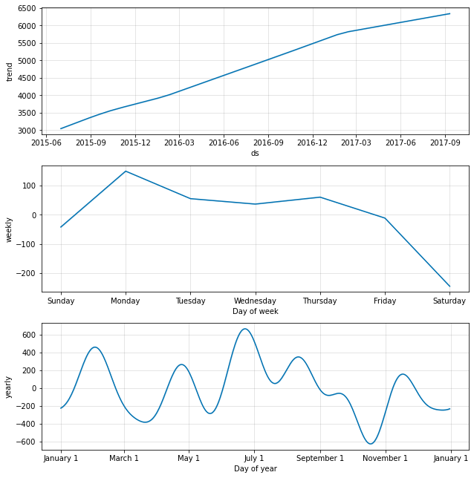
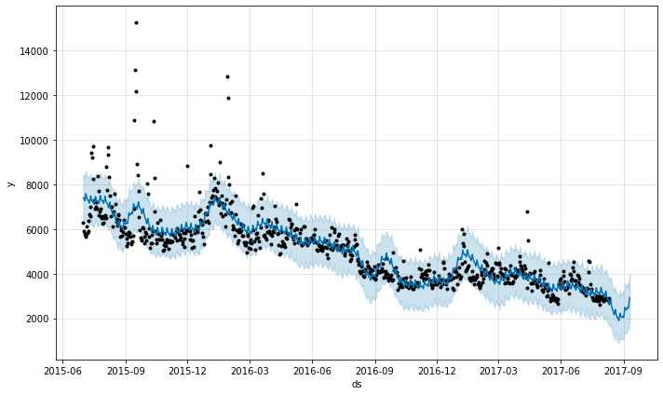
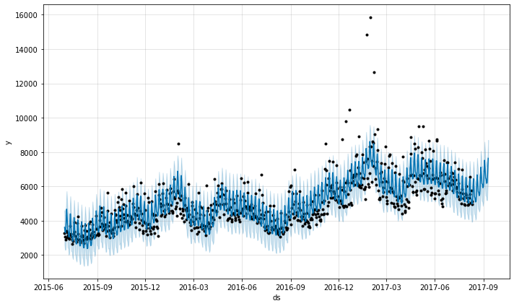
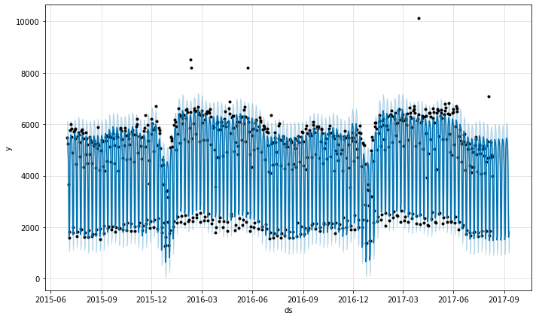
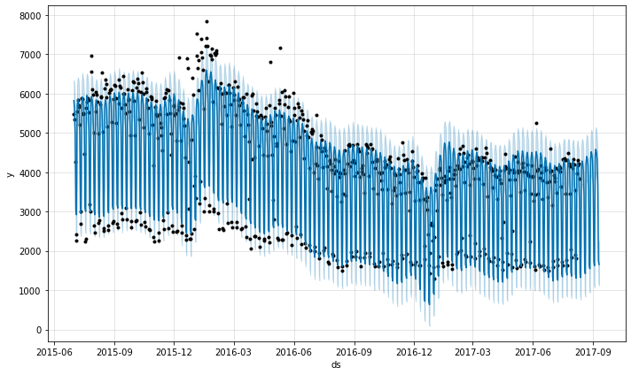
Deep Learning - Prophet
Notes:
Here are the predict results for all of the 5 pages, we can find it can predict not only the long term trend, but also the weekly, monthly seasonalities very well. Take a look at the right plots, this is an example from the first page. We can see the overall trend is growing, for weekly seasonality, weekdays seems greater than the weekends. And there is also a yearly seasonality.

Slide 30
Conclusion

Slide 31
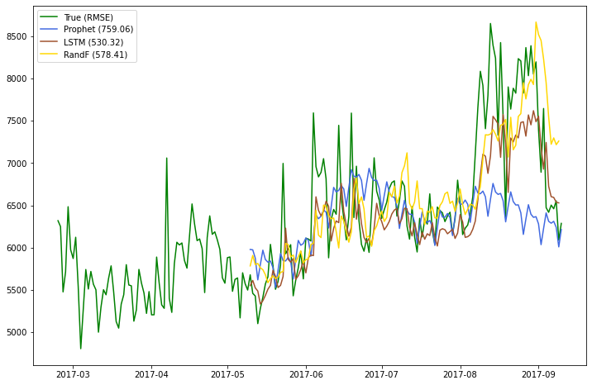
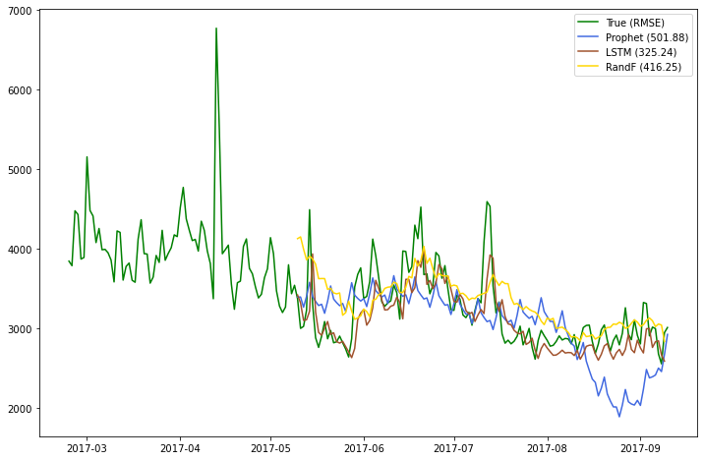
Web Traffic Prediction - Conclusion
LSTM and RF can catch the overall trend
Notes:
Overall, these 5 pages gave us a great baseline to compare different models in different kinds of distribution of dataset. For example, LSTM and RF can easily predict the overall trend and reach a relative small RMSE. As we can see, prophet failed to predict the rocket increase in this period, it even dropped a little bit.

Slide 32
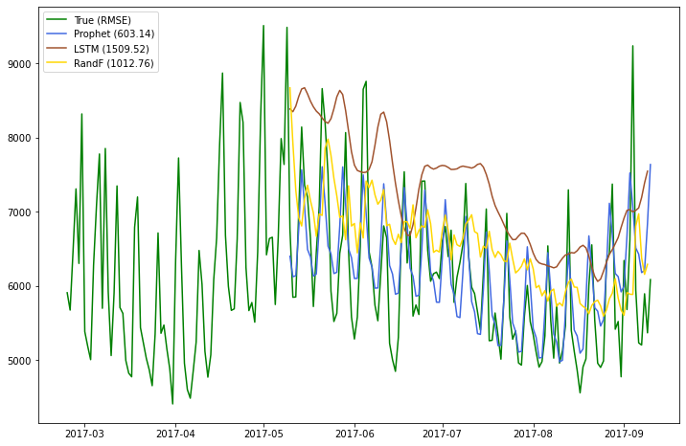
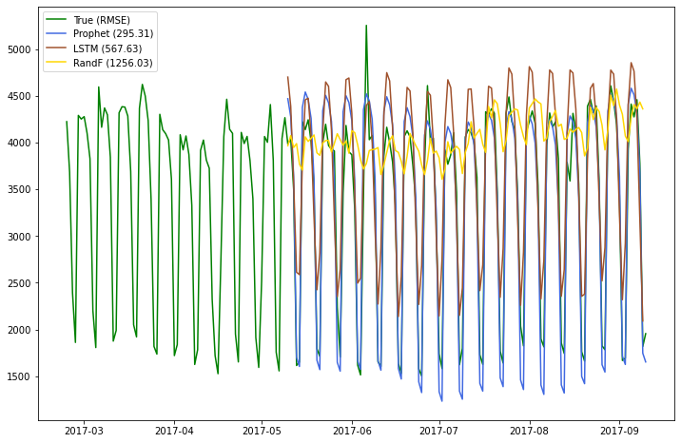
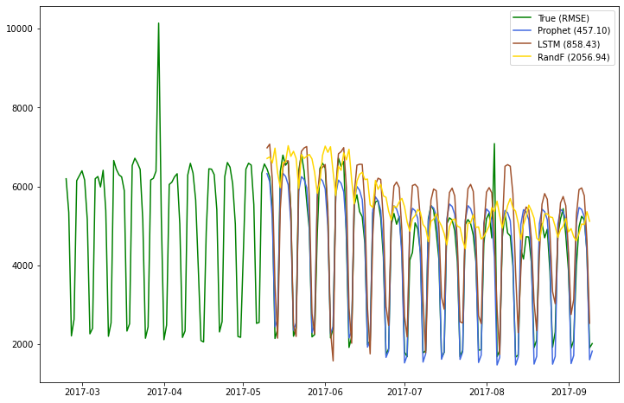
Web Traffic Prediction - Conclusion
Prophet can better extract weekly/monthly seasonality
Notes:
But what can prophet do better is the seasonality, it did surprisingly great in catching these kinds of weekly/biweekly/or monthly seasonality.

Slide 33
Web Traffic Prediction - Conclusion
Model | Pros | Cons
Traditional ML: Random Forest | Flexibility of feature engineering: automatically extract features; can also manually add more relevant features Capture overall trend well | Fail to capture repeated patterns and extreme values Feature extraction is very time-consuming
Deep Learning: LSTM | Architecture flexibility: can add multiple LSTM layers in neural network, bidirectional LSTM Easy to adjust rolling window size based on need | Fail to capture extreme fluctuations
Deep Learning: Prophet | Extremely easy to tune and low data requirement Sophisticated seasonality catch and holiday catch | Cannot fully customize
Good for prediction for pages in bulk
Good for single-page focused prediction
Notes:
So, each model has its own pros and cons. For example, Traditional tree-based model is good in interpretability and LSTM is highly customized and advanced. Prophet is easy to use and tailored to pure time-series datasets. In one word, there is no one fit all model, for specific cases, each model can be the best.

Slide 34
Impact

Slide 35
Web Traffic Prediction - Impact
Non-profit knowledge community
Decision makers
Creators
Developers
Attract donation for a non-profit knowledge community (advertising on high page view pages)
Provide insights to decision makers like non-profits organizations and government
Guide creators to optimize content quality
Help developers to choose pages with similar views to conduct AB testing

Slide 36
Future Improvement

Slide 37
Web Traffic Prediction - Future improvement
Machine Learning: improve feature engineering [ e.g. weekly patterns ], add non-time features
Deep learning: different NN architectures for different patterns
Classical time series models: ARIMA, GARCH

Slide 38
Thank you!
Any questions?

